Slide 1
Structure From Motion
Theory and Application
Taher Azim
Sumeet Suley
Arnab Sen

Slide 2
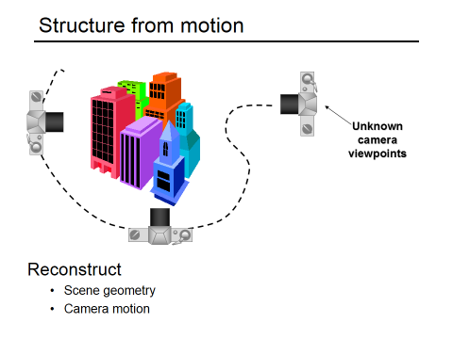

Slide 3

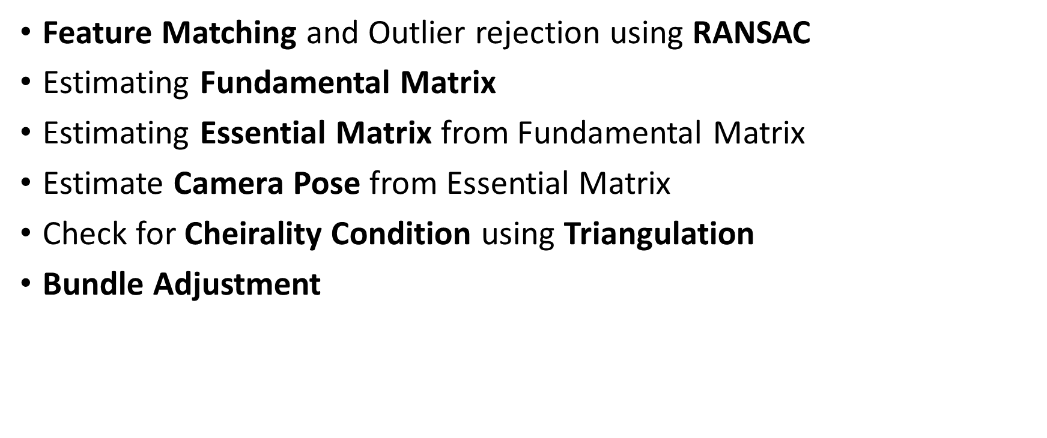

Slide 4
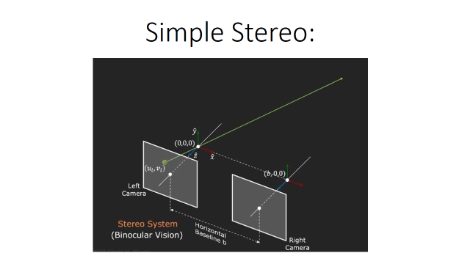

Slide 5
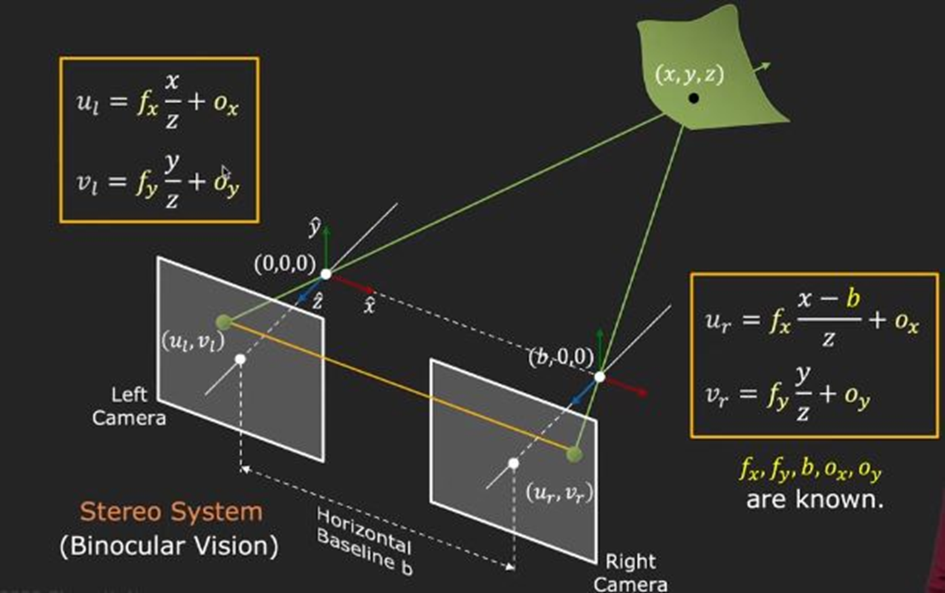

Slide 6
Now the question arises how do you estimate 3D structure from 2 arbitrary views?

Slide 7
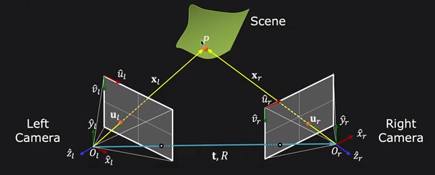
Steps Involved:
1.Assume Camera Matrix K is known for each camera
2.Find Reliable Corresponding points.
3.Find relative camera position t,R

Slide 8
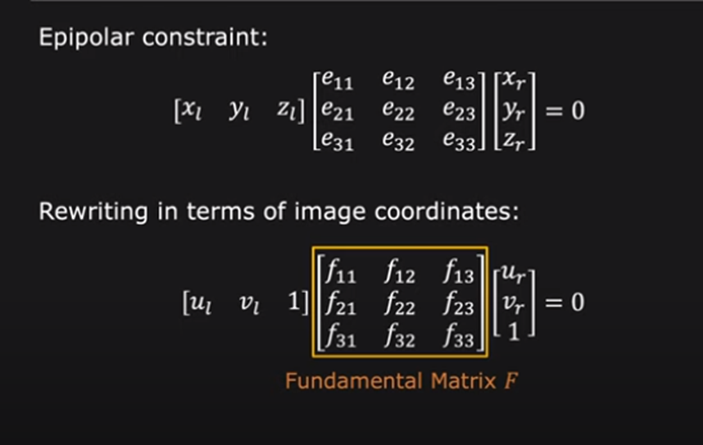

Slide 9
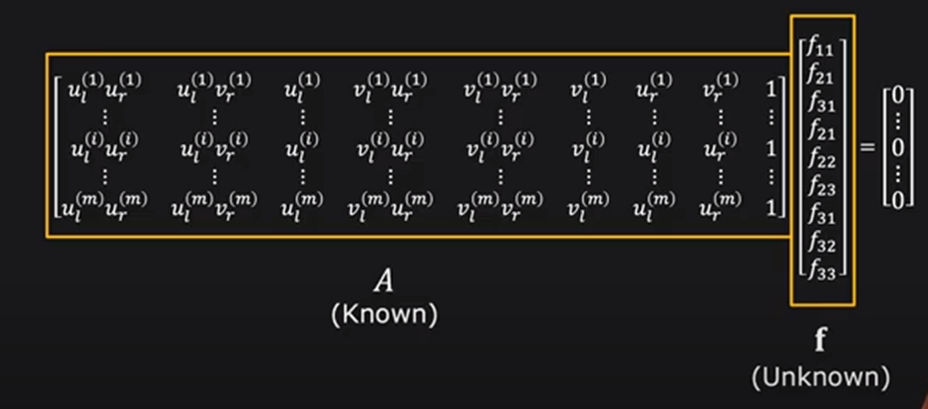

Slide 10
How many points do we need to solve the above equation?
1.Remember homography, where each point correspondence contributes two constraints.
2.Unlike homography, in F matrix estimation, each point only contributes one constraints as the epipolar constraint is a scalar equation.
3.Thus, we require at least 8 points to solve the above homogenous system. That is why it is known as Eight-point algorithm.

Slide 11
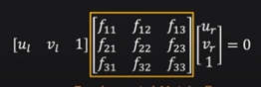
Feature Matching(Finding Correspondences):
Epipolar Line
Finding Matchings using epipolar geometry i.e reducing the problem of finding to 1-d search.
Every scene point has 2 corresponding epipolar lines, one each on two images plane.
Given a point in one image corresponding point in other image must lie on epipolar line.
We have estimated the Fundamental Matrix F thus using below equation we can have straight line equation for right

Slide 12
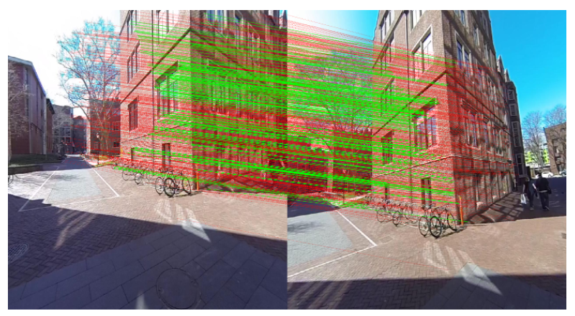
Problem with Feature matching:

Slide 13
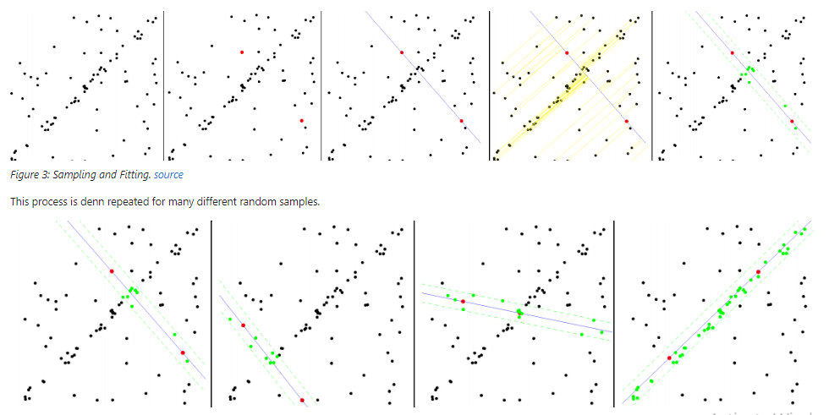
RANSAC for outlier rejection:

Slide 14
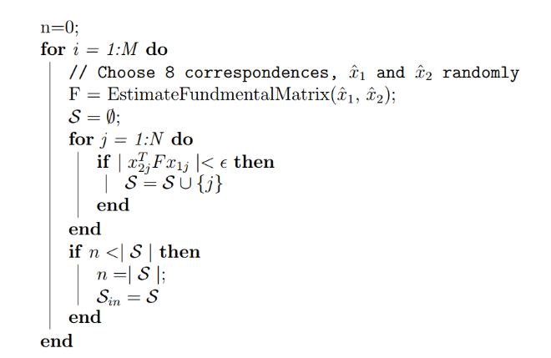

Slide 15
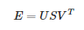
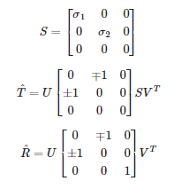
Estimate Camera Pose from Essential Matrix:
When we have the essential matrix E we can decompose it into the rotation R and translation t.
For this we can use the SVD .

Slide 16
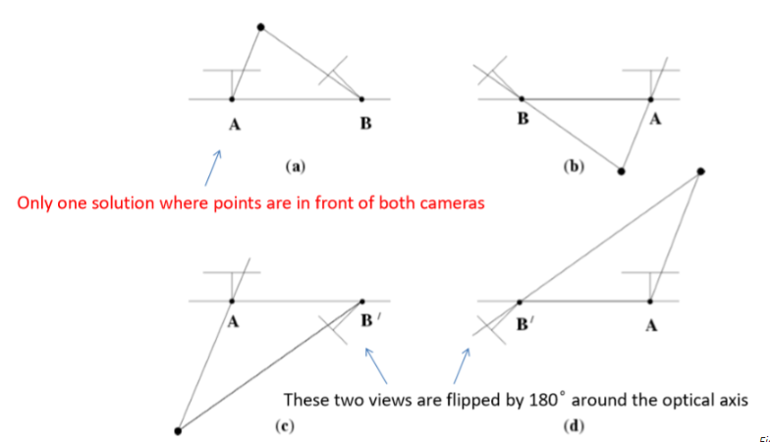
4 Camera Poses:

Slide 17
Check for Cheirality Condition using Triangulation
To check the cheirality condition, triangulate the 3D points (given two camera poses) using linear least squares to check the sign of the depth
Z, Z in the camera coordinate system w.r.t. camera center.

Slide 18
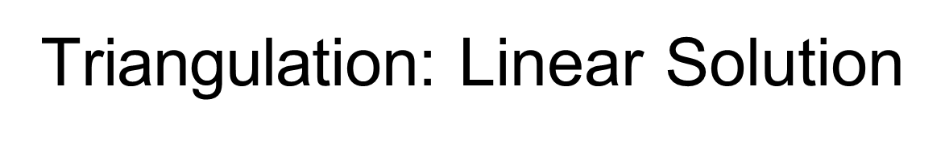
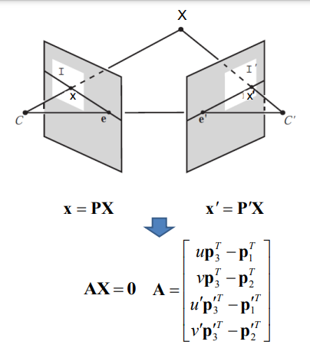
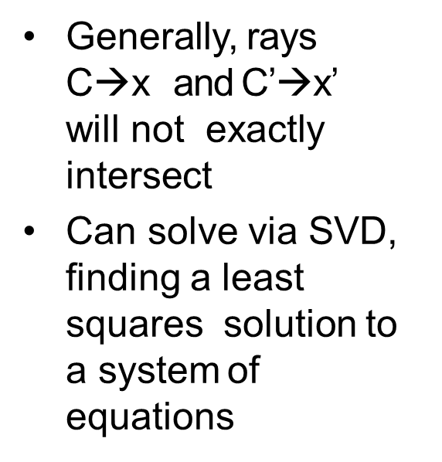

Slide 19
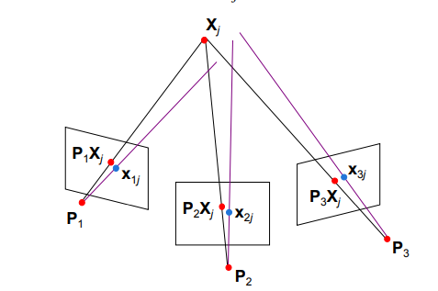
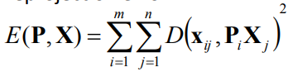
Bundle adjustment:
Once you have computed all the camera poses and 3D points, we need to refine the poses and 3D points together, initialized by previous reconstruction by minimizing reprojection error.
•Non-linear method for refining
structure and motion.
•Minimizing reprojection error

Slide 20
Application of CNNs for low vegetation filtering from data acquired by UAVs
Wojciech Gruszczyński
Edyta Puniach
Paweł Ćwiąkała
Wojciech Matwij

Slide 21
Unmanned Aerial Vehicles (UAVs) is low cost way of collecting data, using photogrammetry on images of relatively small areas
High operational flexibility, High spatial and Temporal Resolution
Developed an algorithm to filter out points that indicate areas covered in low vegetation (grass, crops) from the Generated Point Cloud
Paper presents a three-layer filtering algorithm based on convolutional neural networks (CNNs)
Solutions reduces error in Digital Elevation Model points by 60-70%

Slide 22
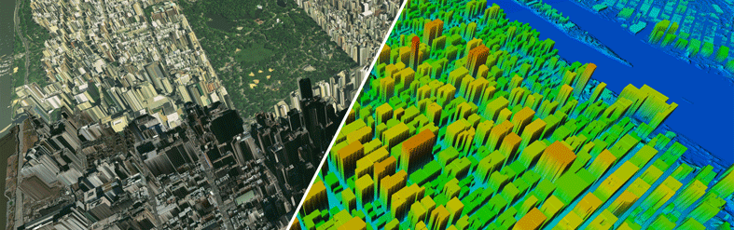
Digital Elevation Model
DEM is a representation of the bare ground (bare earth) topographic surface of the Earth excluding trees, buildings, and any other surface objects

Slide 23
Methodology

Slide 24
Datasets
Datasets acquired at two different locations in the south of Poland
Data from Łaziska : train and validate the network
Data from the village of Jerzmanowice were used for testing
Measurements included a UAV dataset and reference measurements for the height of points located on the ground
During the measurements, objects were divided into regions with the same type and condition of plant coverage
The side and forward overlaps were designed to be at least 50% and 70%, respectively.

Slide 25
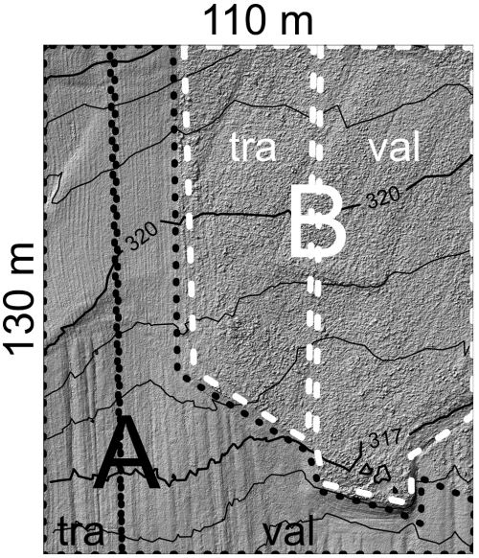
Division of the Łaziska dataset: A - low grass (mowed), B - high grass (about 60 cm tall), tra - data used for network training, val - data used for training validation.

Slide 26
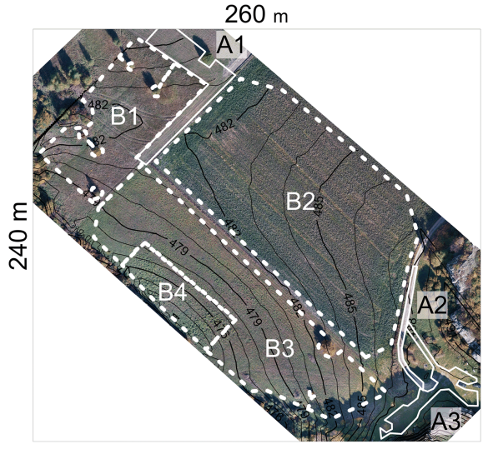
Division of the Jerzmanowice dataset into regions of groundcover with a uniform type and height: A1 - mowed grass, A2 - paved road, A3 - mowed and trodden grass, B1 - wild meadow (grass height of approximately 40–80 cm), B2 - field covered with young broad bean (height of approximately 60 cm), B3 - meadow (grass height of approximately 10–30 cm), B4 - meadow (grass height of approximately 30–50 cm).

Slide 27
Data processing
Classification of the point cloud into the high grass (HG) or low grass (LG) classes
Classification of point cloud fragments that represented the HG class for points reflecting the Ground class and the remaining points (NonGround class)
The determination (regression) and corrections of heights of the points in the cloud for the cloud fragments that were classified simultaneously as the HG class and Ground class
Notes:
Data Processing was done in 3 steps

Slide 28
Preparation of input data
The input data were presented as fragments of a grayscale image, with an 8-bit depth
The entire point cloud was divided into adjacent cells
In each cell, the point with the lowest height was selected and attributed as the height of the cell, while the remaining points were discarded
Cell values were transcribed into the matrix labelled R
The missing entries in the R matrix were filled using a nearest neighbour interpolation method
A G matrix was created by applying a Gaussian filter to the R matrix

Slide 29
Preparation of input data
An M matrix was created as the difference between the R and G matrices:
M = R - G
M matrix elements were processed into a closed interval and saved as an image I
All values of the M matrix elements were processed as follows:
N(i, j) = (M(i, j) min)/(max min)
If N(i, j) < 0 then N(i, j) = 0
If N(i, j) > 1 then N(i, j) = 1
min =- 0.3 m
max =+ 0.3 m
I = round(255 N)
N - values from the M matrix normalized to the range from 0 to 1

Slide 30
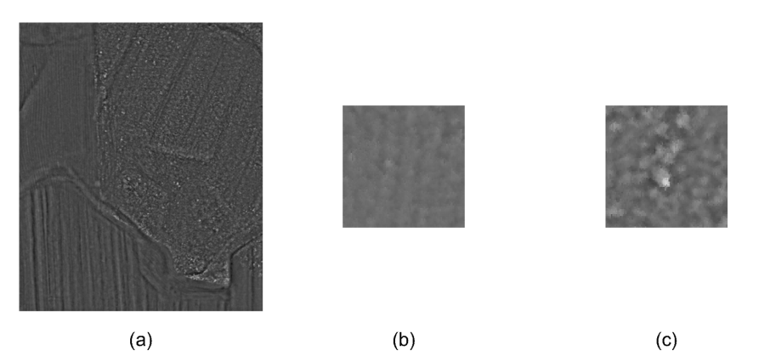
. Full image I for the Łaziska dataset (a) and its exemplary fragments used as the inputs to neural networks from the regions covered by low (b) and high (c) grasses.

Slide 31
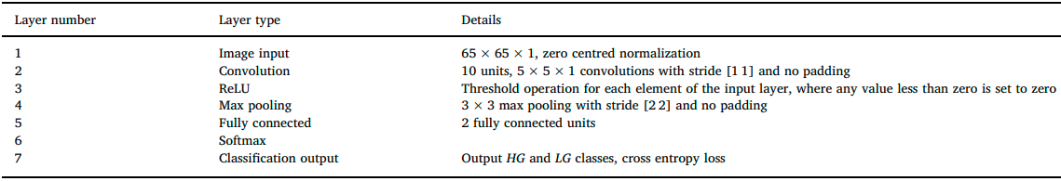
Structure of the CNNs
CNN structure for classification of vegetation into the high grass (HG) and low grass (LG) classes

Slide 32
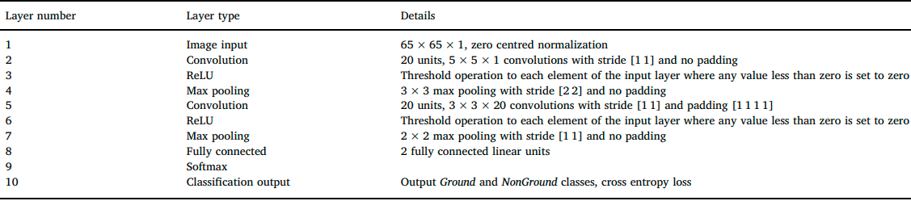
Structure of the CNNs
Structure of the CNN to classify the points into the Ground and the NonGround classes

Slide 33
Results

Slide 34
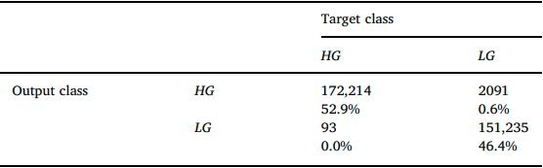
Results
The effectiveness of the neural network was considered to be very high, as 99.3% of the cases were correctly classified
Confusion Matrix

Slide 35
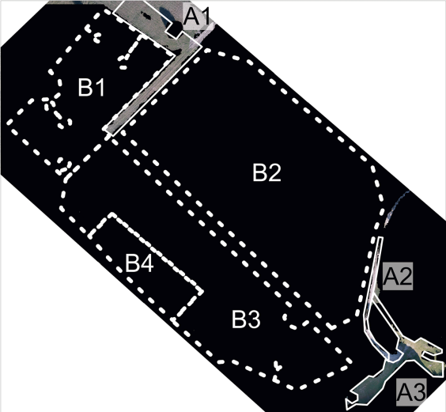
Points classified by the CNN as high grass (HG class - black pixels)

Slide 36
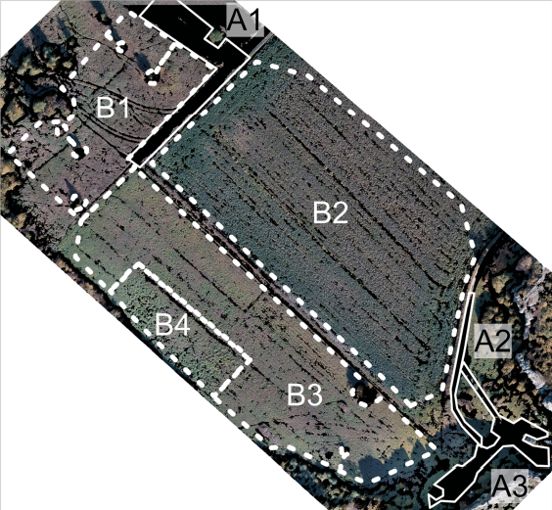
Points of the Jerzmanowice dataset classified as terrain (Ground class - black pixels)

Slide 37
Conclusion
The use of CNNs with the proposed input data formulation enabled the correct classification of areas as low or high grass in nearly all cases, and therefore there is no need to improve the filtering stage
Classification of the cloud points as ground or non-ground points using the CNN gave promising results, but requires further processing or training using a more extensive dataset

Slide 38
Application Of SfM
For Scour Hole Analysis

Slide 39
About The Paper - “Demonstration of SfM and CRP technique for scour hole analysis”
It carried out using manual data collection methods that employed traditional instruments such as point gauges or sensors.
In case of scour analysis, the main concern is the identiﬁcation of the maximum scour depth and three-dimensional (3D) description of scour hole due to limited measured data by manual methods. The data is commonly collected at some selected points. The point data is later used to deﬁne the shape of the scour hole either in the form of depth contours or a 3D view of the scour hole.
A set of experiments are conducted in a laboratory ﬂume to demonstrate the applicability of automated CRP for scour hole analysis.
Two different piers, namely, circular and hexagonal are chosen. 3 circular and 3 hexagonal piers.

Slide 40
Material & Methods
Setup:
Two different pier geometries are chosen, namely, circular (usual) and hexagonal (streamlined pier).
The circular and the hexagonal piers are ﬁrmly secured below the sand bed level by 25 cm and 15 cm respectively preceding to the experimental runs.
It is observed that the fully developed ﬂow is attained at approximately 4.7 m away from the inlet of the ﬂume as the vertical velocity distribution is logarithmic.
The pier is then located at approximately 5.75 m from the inlet. The centre of the pier is taken as (0, 0) as the local co-ordinate for the measurement of scour hole.

Slide 41
Procedure
The respective pier model is embedded in the ﬂume and the sediment bed surface in the ﬂume is levelled to 100 cm from the bottom reference with the help of a point gauge.
The thickness of laid sediment bed is 25 cm and uniform throughout the ﬂume.
Three different discharges are used to study erosion around each geometrical pier. The water is slowly released into the ﬂume.
The required water depth and surface slope are achieved by controlling the tail-gate.

Slide 42
Procedure (contd.)
5. Each experiment is run for three hour duration for scour hole development.
6. The process was observed to be close to the equilibrium condition. It take upto 3 hours.
7. The ﬂow depth in the ﬂume is maintained to 10 cm in all the cases by adjusting the tailgate.
8. The water in the ﬂume is allowed to drain off by carefully operating the tail gate after
complete experimental run.
9. The ﬂume is then allowed to dry up so that the bed is clearly visible for data acquisition.
**The runs were shortened because the purpose of this study is only to demonstrate the capability of the SfM–MVS technique to map scour hole in 3D due to sediment transport and not the scour phenomenon.

Slide 43
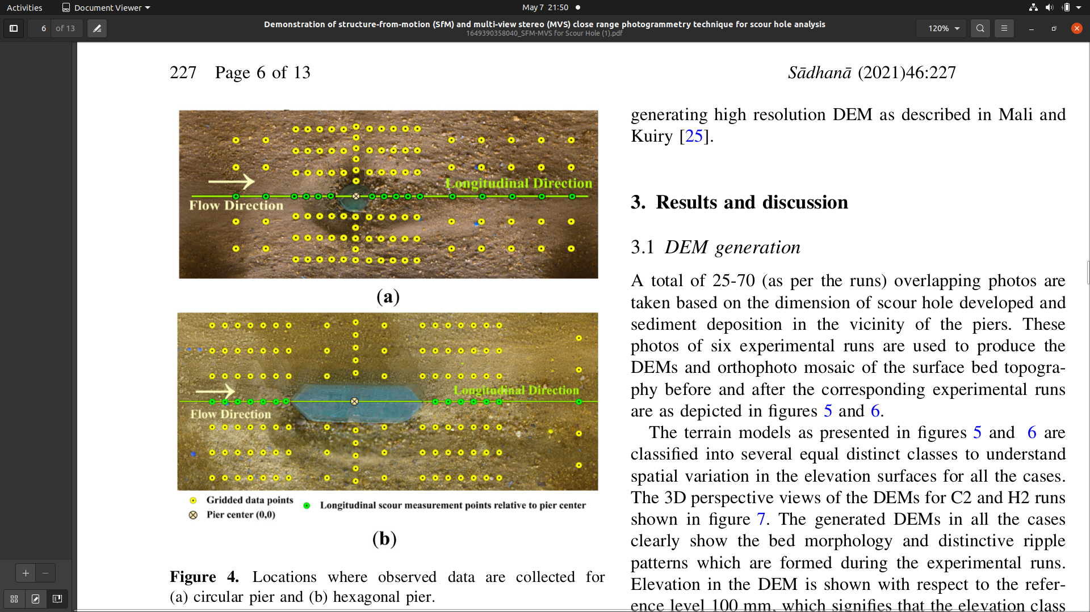
Data acquisition and ground truth data
￼
The distribution of grid points in the ﬁgure are established based on the dimension of scour hole.
The proﬁle of maximum scour depth is observed at the discrete points along the longitudinal direction marked by the green colour line and points.
These scour depth data are collected by point gauge at the gridded points. A set of photos are captured before and after each experimental run using a DSLR camera for the purpose of the automated CRP analysis.
The camera is mounted vertically downwards from a hanging system at a distance of 1.2 m above the ﬂume surface. The camera is operated in manual mode.

Slide 44
Data acquisition and ground truth data (contd.)
The blurred images are discarded from the original set of photographs.
A total of 25-70 (depending on the size of scour hole) images are required for each run.
It is to be noted that each and every ground feature that needs to be reconstructed must be covered by at least three images taken from different positions and orientations, and preferably more in number to enhance the reconstruction accuracy.
The SfM technique is less sensitive to colour and resolution of the images, and hence position and orientation of the camera is not a matter of concern.

Slide 45
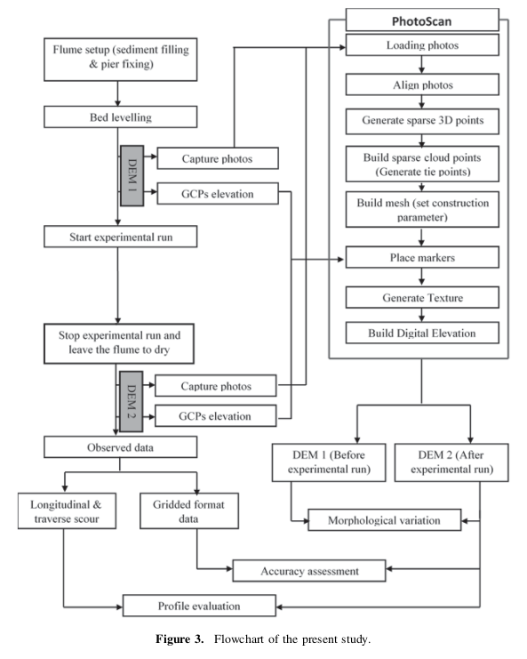

Slide 46
SFM & DEM
The automated CRP available in the commercial Agisoft PhotoScan software is used to generate high spatial resolution bed surface topography.
The PhotoScan uses SfM principle and also takes the advantages of the latest multi-view 3D technology.
SfM component detects feature matching common points in all the photographs, which are stable under viewpoints and match them. Then it generates a descriptor for each point from its local neighbourhood to detect more correspondences across the photos based on the SIFT algorithm.
Then SfM computes the locations of the feature points in a relative coordinate frame by creating sparse 3D points.

Slide 47
The custom algorithm is used to identify the conjugated features between the images and create the 3D sparse point clouds.
A greedy algorithm is then used to ﬁnd approximate camera position, orientation and altitude with respect to 3D sparse point clouds.
3D Sparse Point Clouds 3D Dense Point Clouds 3D Surface
The texture map is generated after the reconstruction of the 3D surface. As a result, the DEM is generated which can be exported by specifying the required spatial resolution parameters.
** Since the Photoscan software is expensive, in order to minimize the cost, a set of freely downloadable packages can be used systematically to execute different steps of the SfM–MVS technique for generating high resolution DEM.

Slide 48
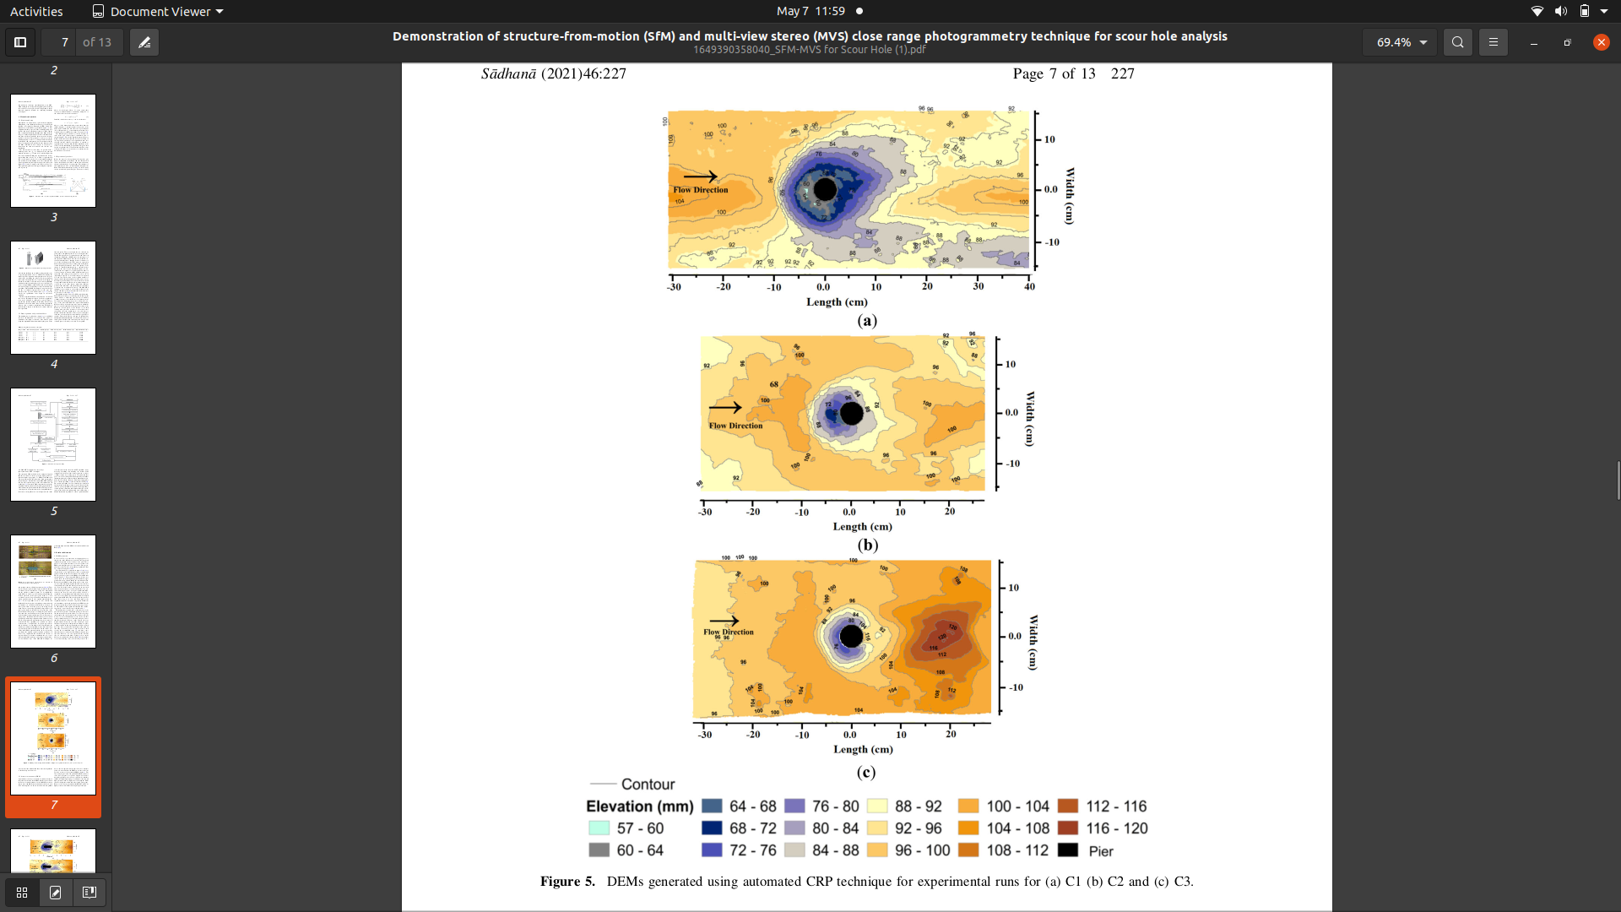
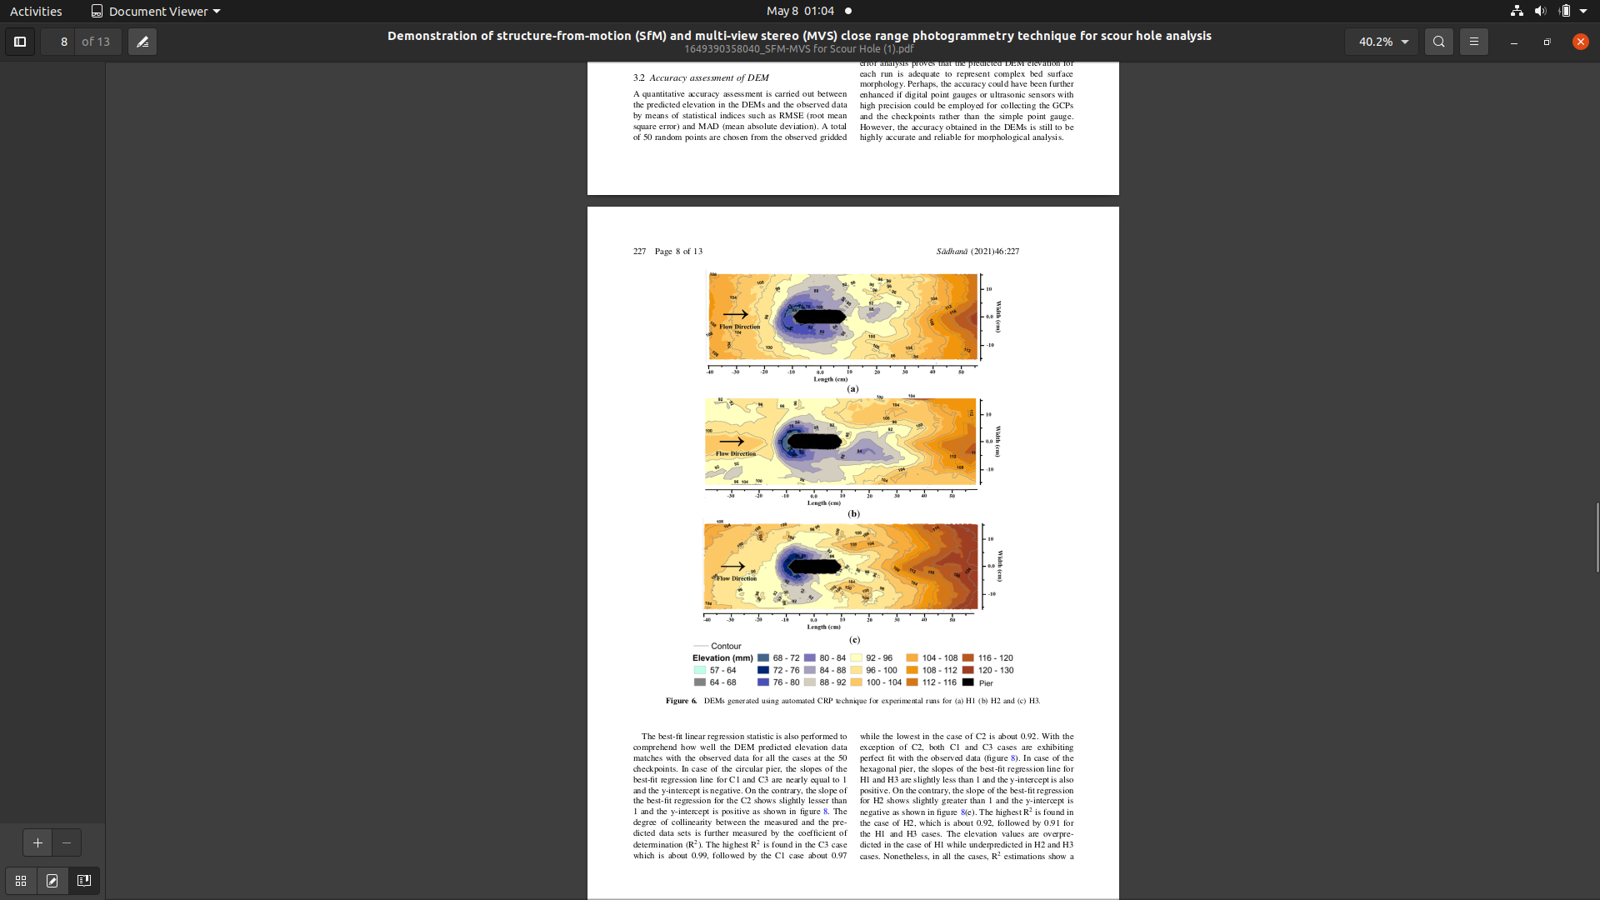
Results

Slide 49
Accuracy Assessment
Using RMSE(Root Mean Square Error) and MAD(Mean Absolute Deviation) for quantitative accuracy between predicted elevation in DEM and observed data.
The error analysis proves that the predicted DEM elevation for each run is adequate to represent complex bed surface morphology.
The accuracy could be better if the ultrasonic sensors had high precision.
The accuracy obtained in the DEMs is still to be highly accurate and reliable for morphological analysis.

Slide 50
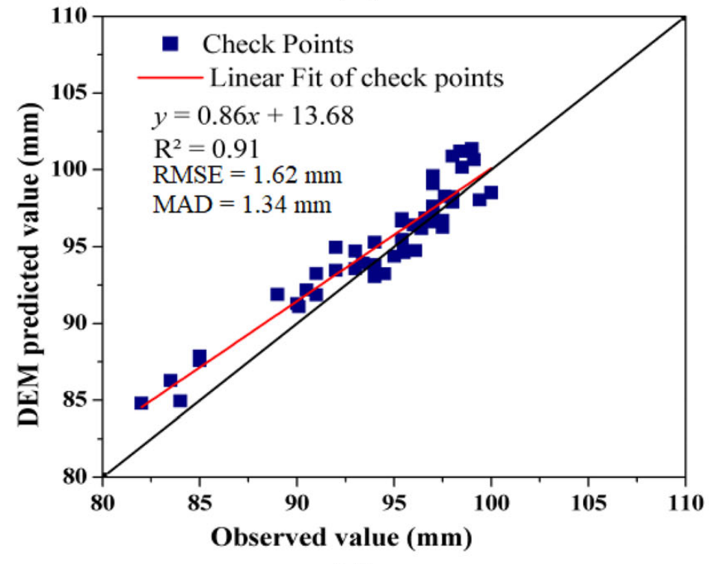
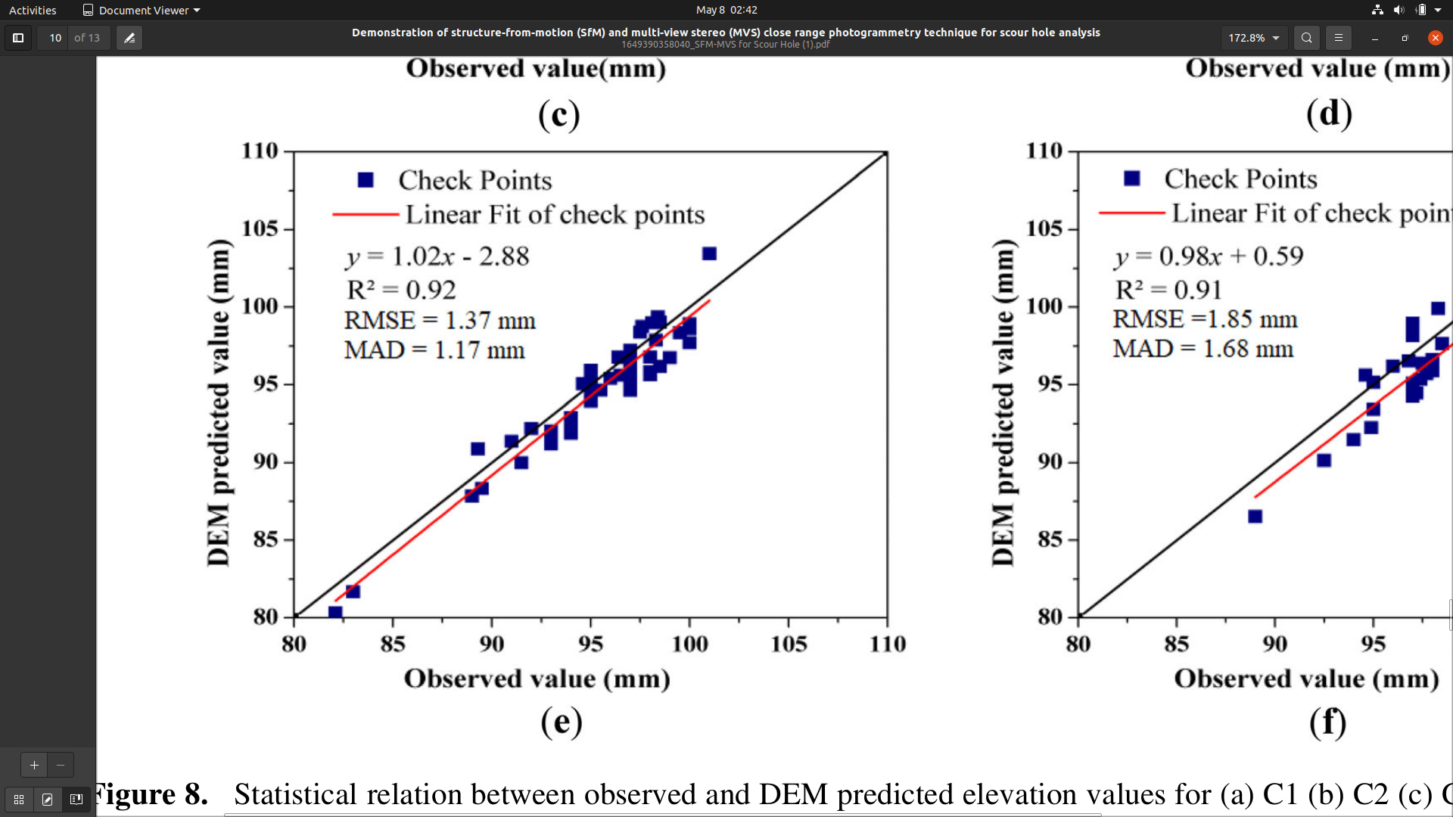
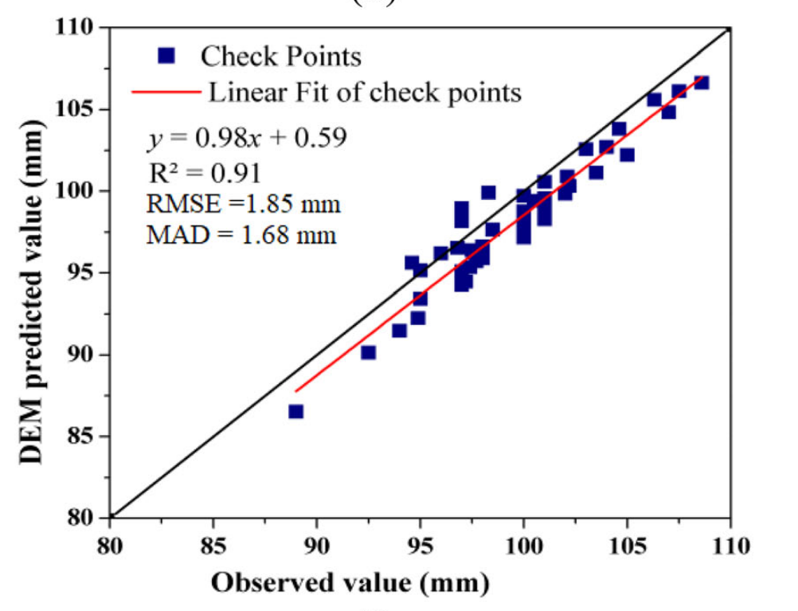
R2
The slope of the best ﬁt regression for H2 shows slightly greater than 1 and the y-intercept is negative as shown in ﬁgure. The elevation values are overpredicted in the case of H1 while underpredicted in H2 and H3 cases. R2 estimations show a highly accurate positive linear relationship between the computed DEM elevation and the measured elevation values.
For H1
For H2
For H3

Slide 51
Cautions
Blurred images can be a cause of mismatching the conjugated points, so they need to be removed from the set of images before the processing. Signiﬁcant overlaps among the images are needed to be maintained.
The degree of orientation from which images are taken should be maintained up to 10° for better accuracy.
Convergent images can be used along with parallel images in order to mitigate the non-linear dome effect in the DEM.

Slide 52
Conclusions
The automated CRP can be applied to any shape of piers.
The accuracy achieved in the DEMs is in the scale of mm to sub-mm. Therefore, it can be concluded that the SfM technique can be used to collect high resolution data for studying morphological changes.
The SfM technique is easy to implement, cost effective and efﬁcient than the classical photogrammetric technique.
Therefore, it can be concluded that the automated SfM CRP technique is an effective alternative for collecting simultaneous and high spatial resolution topographic data for morphological analysis, even for a laboratory setup.

Slide 53
Thank You

